Slide 1
COMPUTER ORGANIZATION AND ARCHITECTURE
Dr. Rizwan Khan
Head – Department of Computer Science and Engineering
(An NBA Accredited Program)
ABES Institute of Technology, Ghaziabad

Slide 2
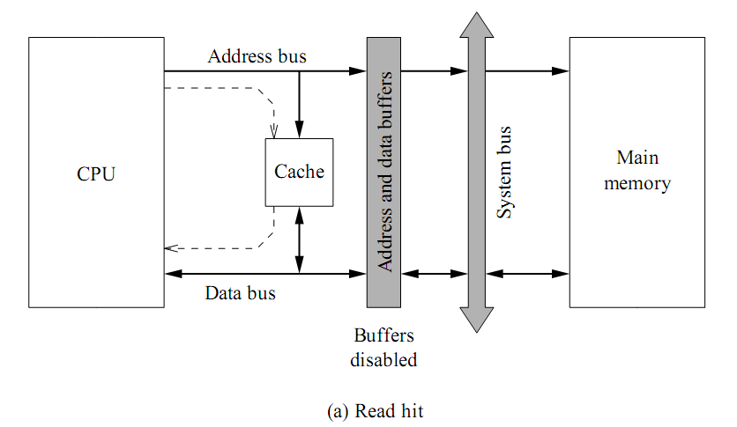
Cache Read Operation

Slide 3
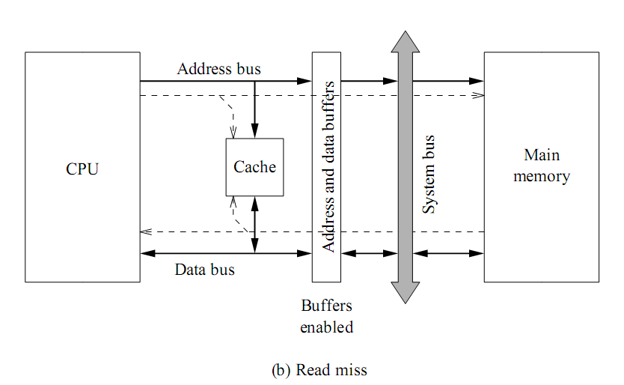
Cache Read Operation

Slide 4
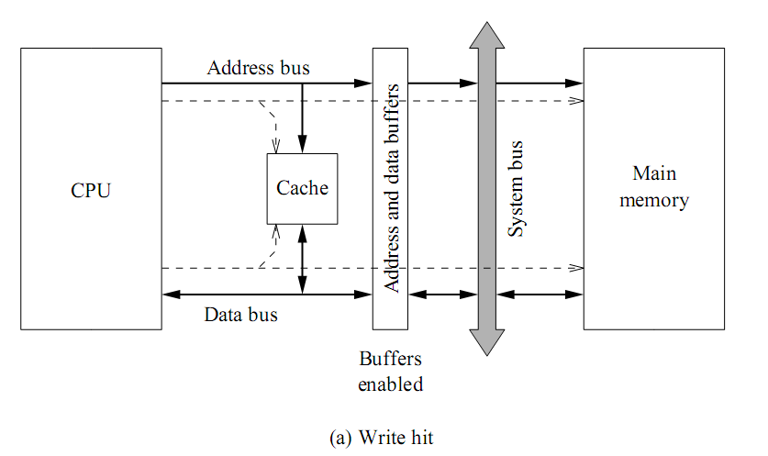
Cache Write Operation

Slide 5
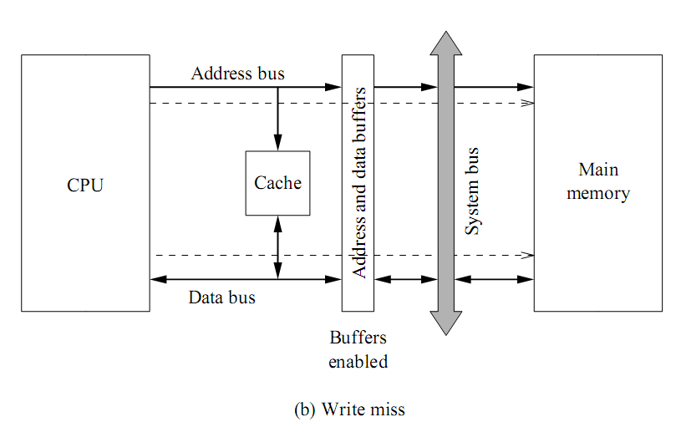
Cache Write Operation

Slide 6
Example
The access time of a cache memory is 50ns and that of main memory is 500 ns. It is estimated that 80% of the main memory requests are for read and the remaining are for write. The hit ratio for read access only is 0.9 and a write through policy is used
Determine the average access time considering only read cycles
What is the average time if write requests are also considered
T = ht_{c} + (1-h)t_{m}
= 0.9 x 50 + 0.1 x 500
= 45 + 50 = 95 ns
T _{r/w} = read prob x t_{read} + (1- read prob)x t_{write}
Read request prob = 0.8
Write request prob = 0.2
t_{read} = 95ns
t_{write} = 500ns (because both memories are updated at the same time)
t_{r/w} = 0.8 x 95 + 0.2 x 500
= 76 + 100 = 176 ns

Slide 7
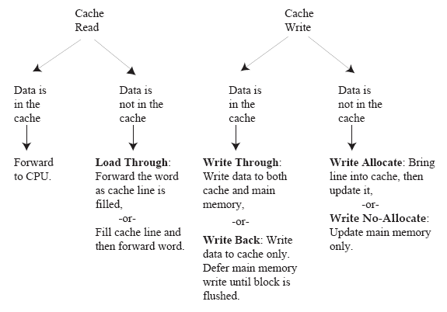
Cache Performance
Cache read and write policies

Slide 8
CACHE WRITE
Cache Memory
Write Through
When writing into memory
If Hit, both Cache and memory is written in parallel
If Miss, Memory is written
For a read miss, missing block may be
overloaded onto a cache block
Memory is always updated
-> Important when CPU and DMA I/O are both executing
Slow, due to the memory access time
Write-Back (Copy-Back)
When writing into memory
If Hit, only Cache is written
If Miss, missing block is brought to Cache and write into Cache
For a read miss, candidate block must be
written back to the memory
Memory is not up-to-date, i.e., the same item in
Cache and memory may have different value

Slide 9
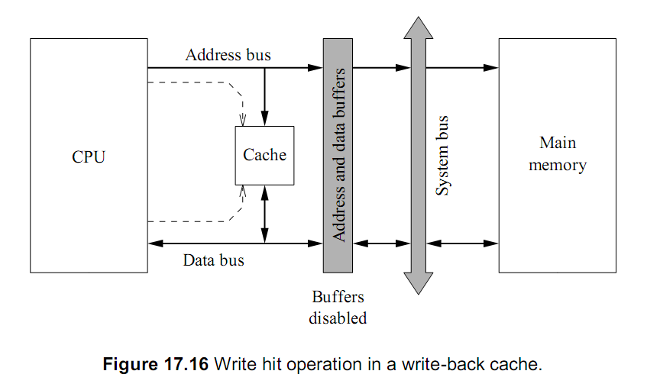
Write Back Policy

Slide 10


